Slide 1
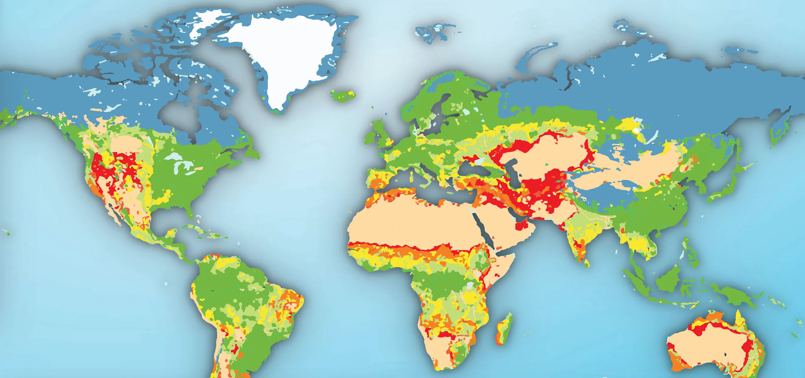



The Use of Geoinformation
in (Anticipatory)
Humanitarian Action
Karen Dall, Alec-Schulze Eckel und Melanie Eckle-Elze

Slide 2
Session 1.: Coordinates, geodata and QGIS
Time | Content
10:25 | Where can I find help?
11:00 | Projections- Why all world maps are wrong!
11:00-11:15 | Coffee break
11:15 | Geo data and data formats
12:00 | QGIS and data import 1/2
12:00-12:15 | Coffee break
12:15 | QGIS and data import 1/2
13:00 | Intro to Self-Study task and feedback

Slide 3
Where can I find help?
GitLab Wiki
https://gitlab.com/Alec-SE/gis-in-anticipatory-humanitarian-action/-/wikis/home
Youtube
You can search on Youtube for any problem you might have!
QGIS Tutorials
http://www.qgistutorials.com/en/

Slide 4
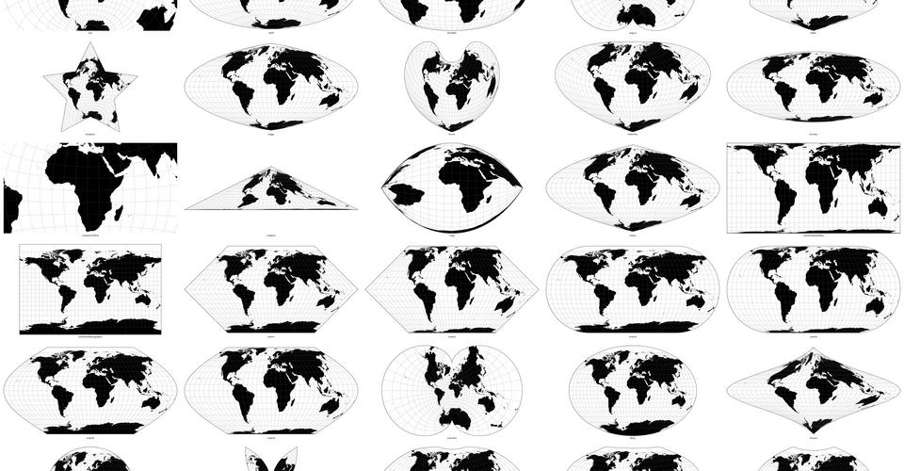
Projections
Why all world maps are wrong

Slide 5
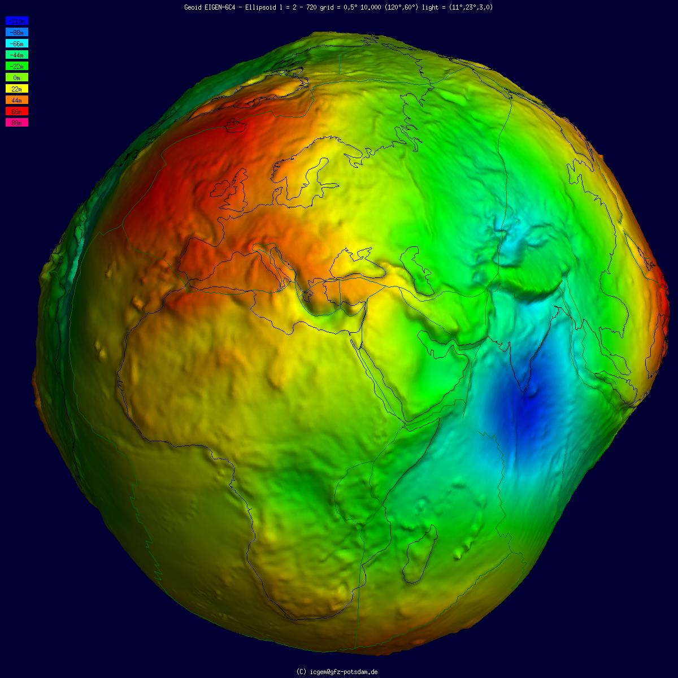
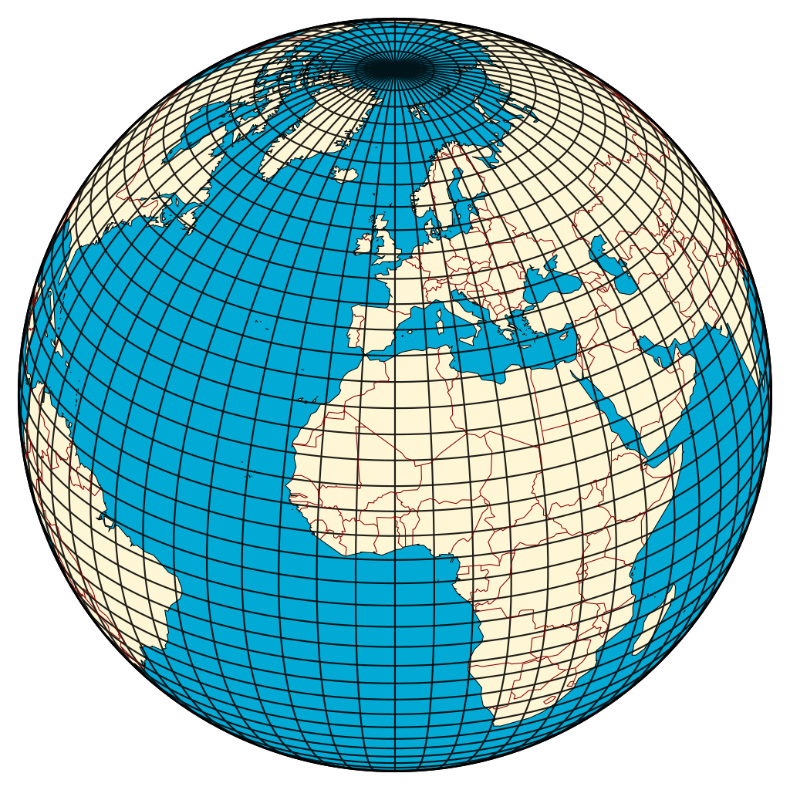
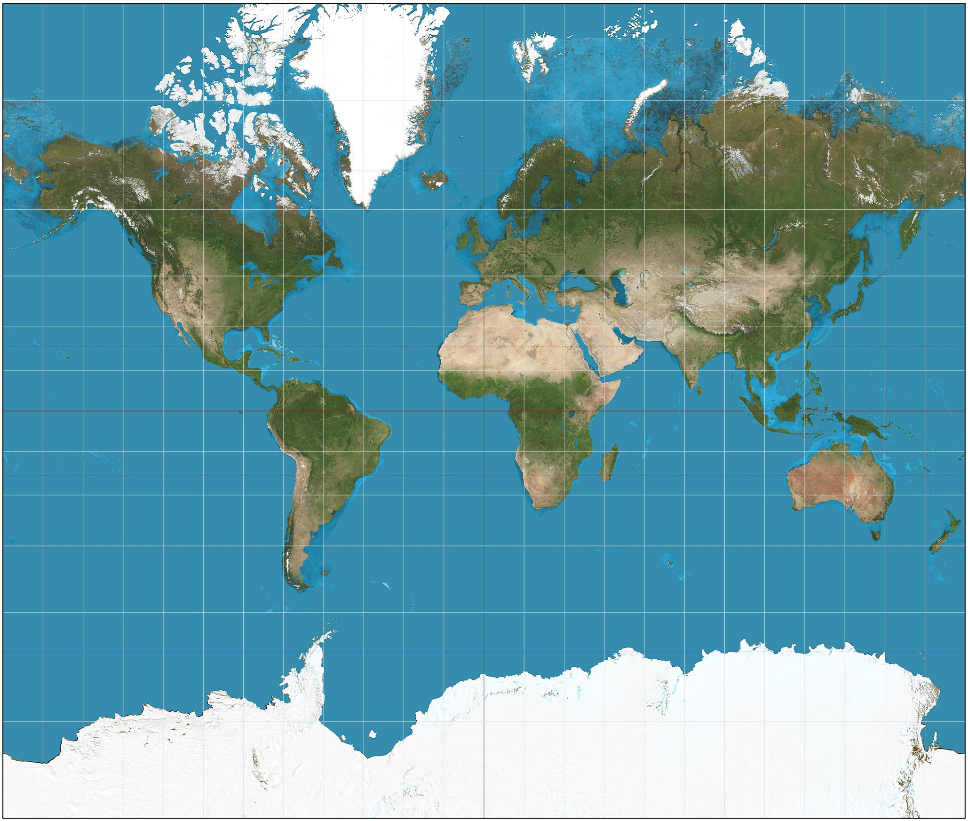
From round to flat
Geographical coordinate system
Projected coordinate system
Geoid
International Centre for Global Earth Models (2019)
Wikimedia- Hellerick (2013)
Wikimedia- Strebe (2011)
Notes:
https://en.wikipedia.org/wiki/Geoid#/media/File:Geoid_undulation_10k_scale.jpg
https://commons.wikimedia.org/wiki/File:Division_of_the_Earth_into_Gauss-Krueger_zones_-_Globe.svg
https://commons.wikimedia.org/wiki/File:Mercator_projection_SW.jpg

Slide 6
Geographical coordinate system vs. Projected coordinate system
Geographical coordinate system
Projected coordinate system
Wikimedia- Hellerick (2013)
Wikimedia- Strebe (2011)
Uses degree, minutes and seconds
Can be used with meters and kilometers
Notes:
https://en.wikipedia.org/wiki/Geoid#/media/File:Geoid_undulation_10k_scale.jpg
https://commons.wikimedia.org/wiki/File:Division_of_the_Earth_into_Gauss-Krueger_zones_-_Globe.svg
https://commons.wikimedia.org/wiki/File:Mercator_projection_SW.jpg

Slide 7
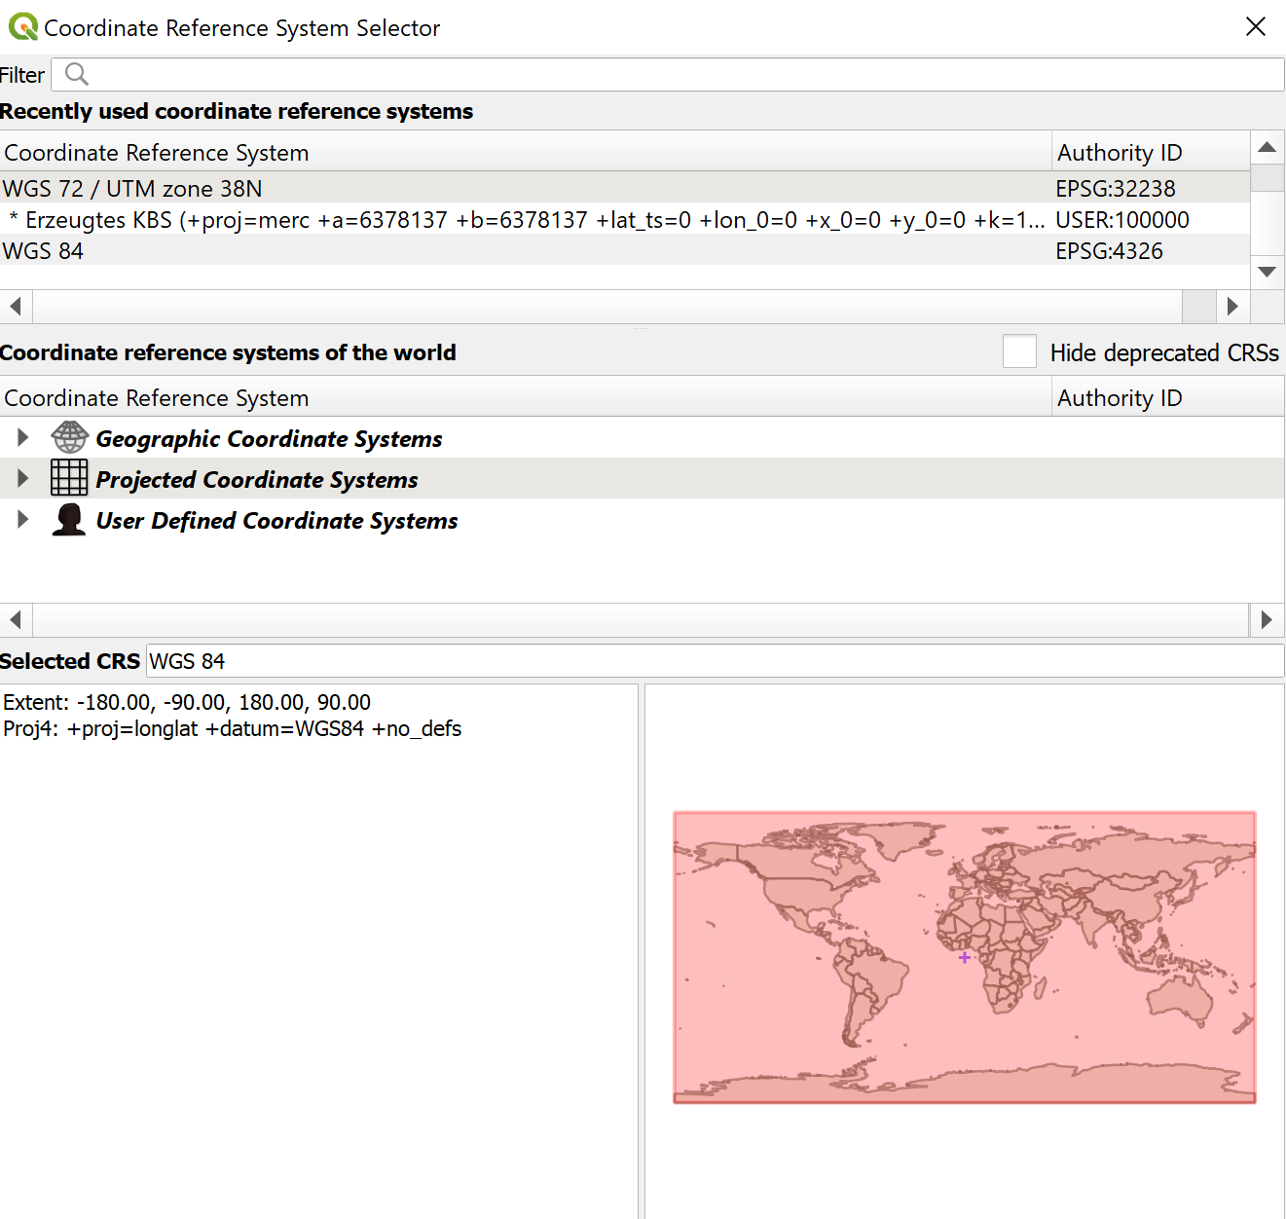
Reprojecting in QGIS

Slide 8
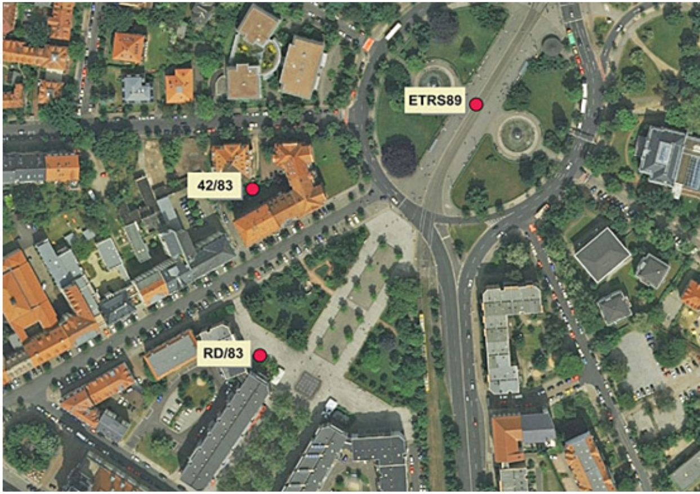
Wrong reference systems

Slide 9
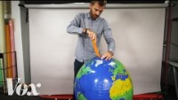
Why all world maps are wrong - wrap up
Key take aways:
We need to be aware of the used reference system
All data in a GIS project must be projected in the same reference system
Why all world maps are wrong
Notes:
https://www.youtube.com/watch?v=kIID5FDi2JQ

Slide 10
Geodata
Notes:
michaelminn.net/tutorials/gis-data/index.html

Slide 11









Geodata
Gender Equality
Logistics
Sustainability city's
Green energy
Agriculture
Environmental protection
Water resources
Poverty reduction
Disaster risk management
Ambulance service
And many more…

Slide 12
Vector data
Notes:
michaelminn.net/tutorials/gis-data/index.html

Slide 13
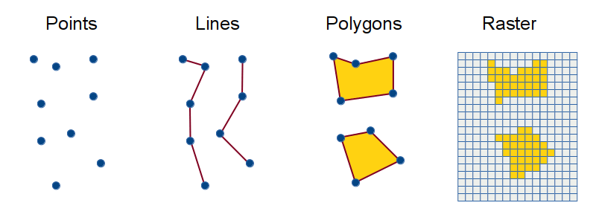



Geodata- Vector data
Vector data
Modified from Minn, M.

Slide 14
Vector data tables
Geometry
Attribute data (example)
ID | Elevation | Temerature
101 | 100 | 11.7
103 | 65 | 9.854
ID | Length | Road type
54 | 133.4 | Main road
3 | 67.1 | Farm path
ID | Area | Land use
54 | 5520.10 | Urban
3 | 312.3214 | Agriculture
Modified from Minn, M.

Slide 15
Vector data formats
Format name
Use
Shapefile (.shp)
GeoJSON (.geojson)
Keyhole Markup Language (.KML)
GPS Exchange Format (.gpx)
GeoPackage (.gpkg)
Standard but dated
Wide use in OpenStreetMap
Wide use in Google Earth
Use in GPS devices
New and versatile

Slide 16
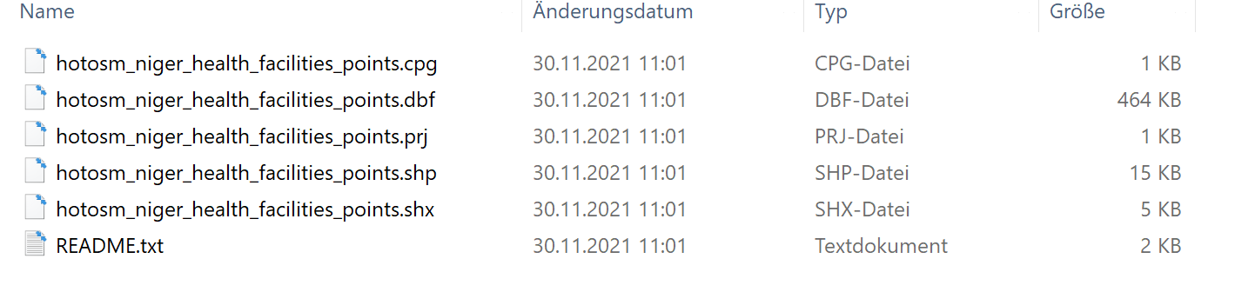
Shapefile (.shp)
Format name
Components
Shapefile (.shp)
.shp —geometry
.shx — Link geometry and attributes
.dbf — attributes
.prj — projection
…

Slide 17

Vector data - wrap up
Key takeaways:
Shapefiles consist of multiple files and must be stored together
Be aware that all geodata imported in QGIS must be in the right projection
GIS File Formats and Good Practice

Slide 18
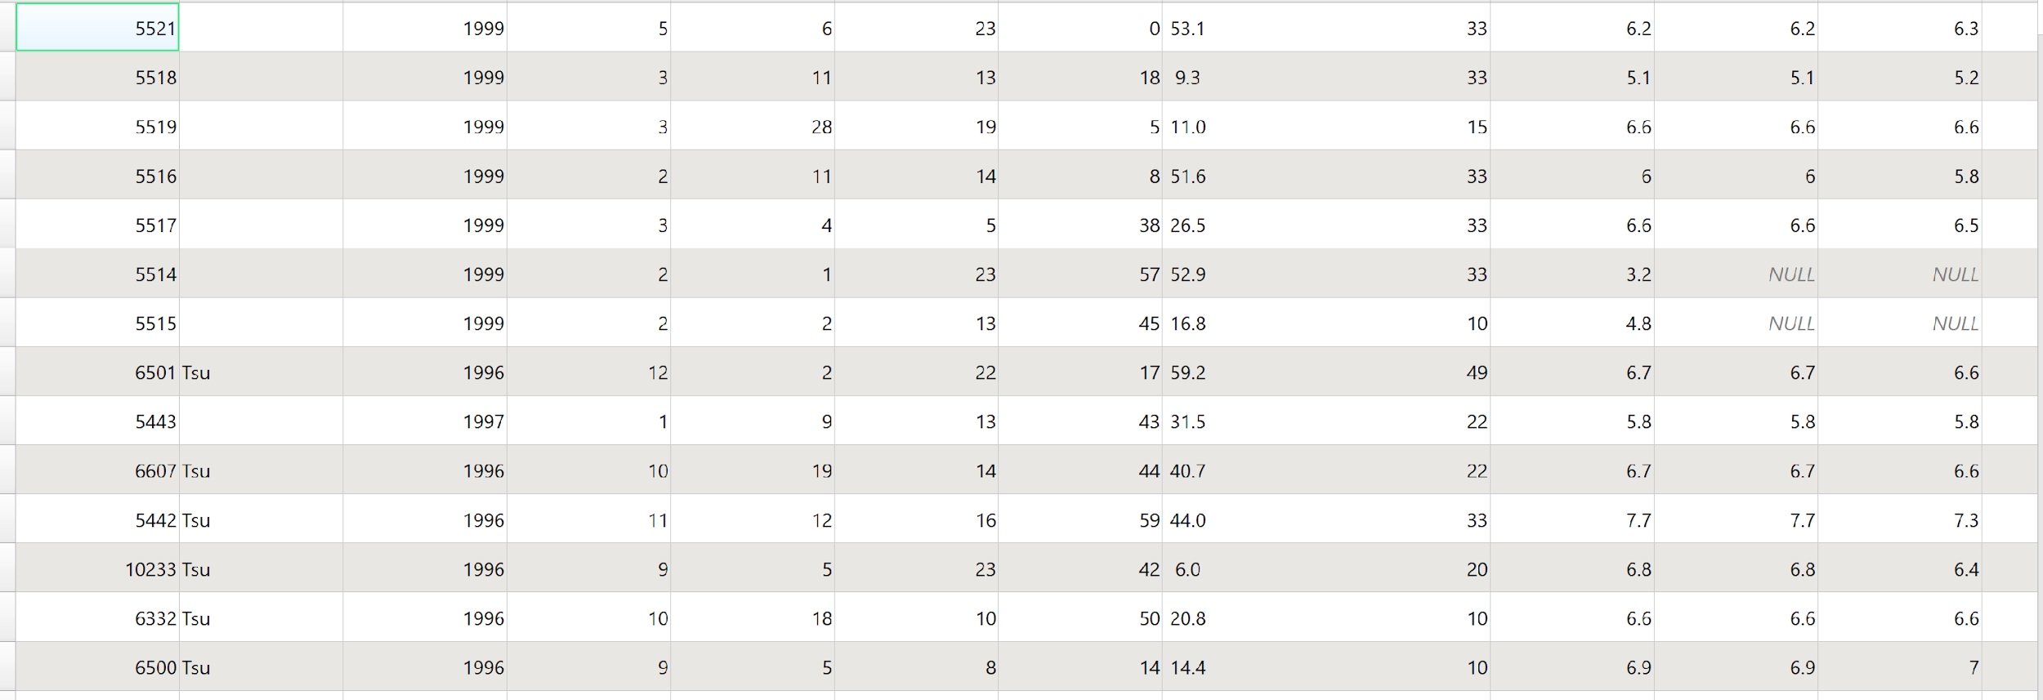
Data in text format

Slide 19

Data in text format
Text file
ID | Elevation | Temperature | Latitude | Longitude
101 | 100 | 11.7 | 30.512 | 79.403
103 | 65 | 9.854 | 41.026 | 74.284
Geometry
Possible data formats:
Excel (.xlxs)
CSV (.csv)
Text (.txt)

Slide 20
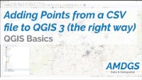
Text data - wrap up
Key takeaways:
To use text data directly in QGIS the data must have “Latitude” and “Longitude” columns.
Add points from a CSV file to QGIS 3 (the right way)

Slide 21

Data storage and good practice
Three folders for data storage:
Original data
Interim results/ Temporal
(final) Results
No data on desktop
Do not use special characters (!, ?, etc.), slash or dash (/ -) or blank spaces. You can use _ instead.
For our German speakers, please do use „umlaute“ (ä, ö, ü).
Original data/ database
Interim results / Temporal
(final) Results

Slide 22
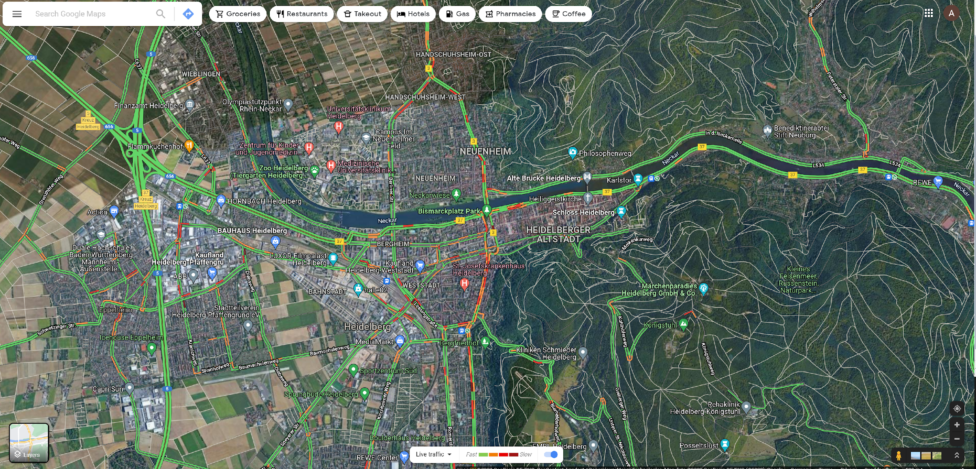
Layer Concept

Slide 23
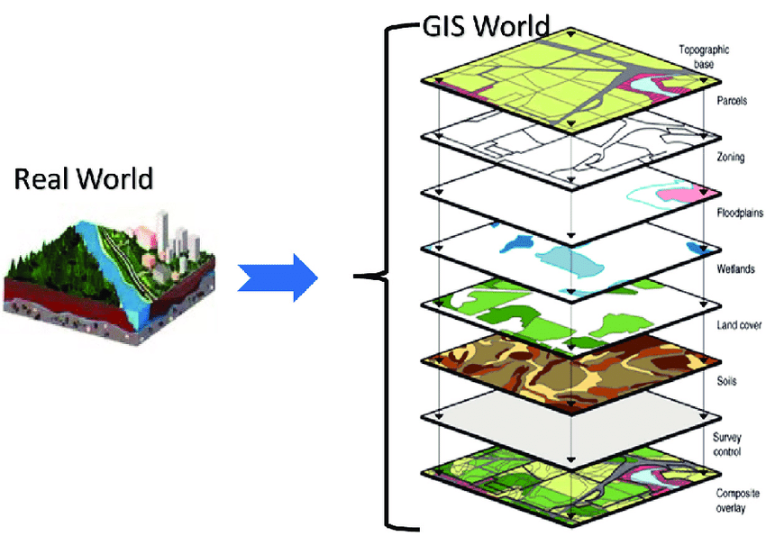
Layer Concept
(Acharya and Lee 2019, p. 3934)

Slide 24
QGIS Intro
Hands on

Slide 25
Surface
Settings
Navigation
Bookmarks
Toolbars
Base maps
Plugins
Layers
Measurement

Slide 26
Data import and projects
Import vector data
Saving data
Reprojecting data
Saving a project
Import text data
Exercise_0

Slide 27
Self-Study
Data import

Slide 28
Self study data import
GitLab Exercise_1

